Slide 1
Inter-Process Communication
Understanding IPC Mechanisms in Operating Systems

Slide 2
What is Inter-Process Communication?
Mechanism for processes to exchange data and information
Essential for cooperating processes to coordinate and collaborate
Enables processes to read, write, and communicate efficiently
Reduces redundancy in system operations
Improves system resource utilization and performance

Slide 3
Why Inter-Process Communication Matters?
Facilitates complex multi-process applications
Allows real-time data sharing between processes
Enables synchronization and coordination
Critical for client-server architectures
Foundation for distributed computing systems
Essential for system stability and modularity

Slide 4
Two Primary Models of IPC
Shared Memory
Systems
Message Passing
Systems
• Processes share memory
• Direct data read/write
• Faster communication
• Minimal kernel involvement
• Requires synchronization
• Use send() and receive()
• Messages in buffers
• Works across networks
• Heavy kernel involvement
• Slower but safer

Slide 5
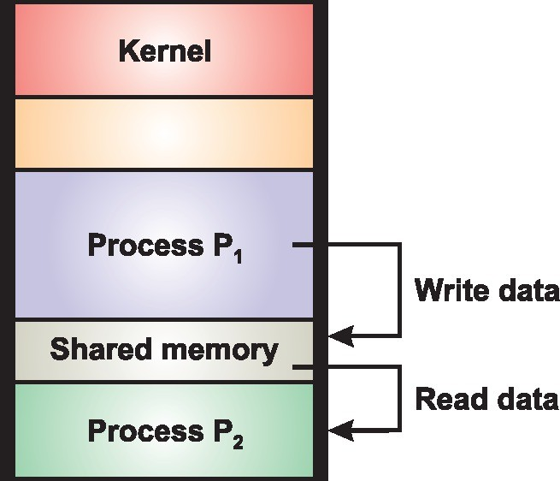
Shared Memory Systems
Processes create and attach to shared memory segments
All cooperating processes can read and write data
Communication occurs through the shared area
Minimal kernel involvement after setup
High speed communication between processes
Critical: Synchronization required to prevent data corruption

Slide 6
Advantages of Shared Memory Systems
Very fast communication - data directly accessible
Low overhead - system calls needed only for setup
Flexible - processes can share large data structures
Efficient for high-volume data transfer
No message copying overhead
Good for processes on the same machine
Simple implementation for basic use cases

Slide 7
Producer-Consumer Problem
Classic example of IPC in shared memory systems
Producer Process: Generates items and places them in buffer
Consumer Process: Removes items and consumes them
Key Challenge: Coordination between producer and consumer
Buffer acts as intermediate storage
Must prevent buffer overflow and underflow
Requires proper synchronization mechanisms

Slide 8
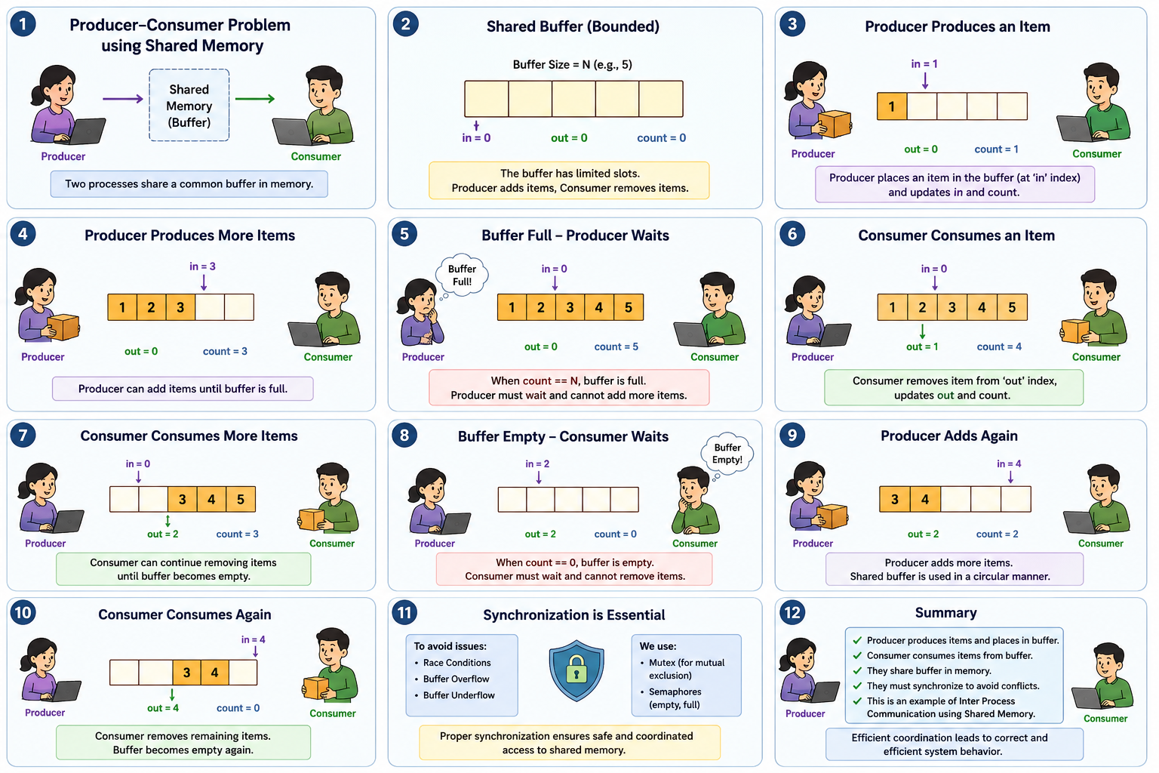

Slide 9
Buffer Types in Producer-Consumer
Bounded Buffer
Unbounded Buffer
• Fixed size buffer
• Producer waits if full
• Consumer waits if empty
• Prevents memory overflow
• Resource-controlled
• Unlimited capacity
• Producer never waits
• Consumer waits if empty
• Requires large memory
• Simple operation

Slide 10
Circular Buffer Implementation
Common approach for bounded buffer implementation
Uses circular array to maximize buffer space
Two pointers: 'in' and 'out' for tracking positions
Initial state: Both pointers set to zero
Wrap-around: When pointer reaches size, resets to zero
Condition for full: (in + 1) % size == out
Condition for empty: in == out
Efficient use of fixed memory space

Slide 11
Synchronization in Shared Memory
Critical Issue: Data corruption if multiple processes access simultaneously
Solution: Use mutual exclusion (mutex) locks
Implementation: Semaphores, mutex variables, or other locking mechanisms
Ensures: Only one process accesses shared memory at a time
Prevents: Race conditions and data inconsistencies
Trade-off: Performance vs. data integrity
Notes:
n shared memory, multiple processes access the same memory location.
If two or more processes try to modify the same data at the same time, the data can become incorrect or inconsistent.
This problem is known as a race condition.
To prevent two processes from modifying shared memory simultaneously, the operating system provides mutual exclusion (mutex).
A mutex acts like a lock.
Before accessing shared memory, a process acquires the lock.
While the lock is held, no other process can enter the critical section.
After completing its work, the process releases the lock.
The operating system provides several synchronization mechanisms:
a) Mutex
A simple lock.
Only one process can own it at a time.
Best for:
Protecting one shared resource.
b) Semaphore
A semaphore is a synchronization variable controlled by two operations:
Wait (P) → Decreases the semaphore value and checks if access is allowed.
Signal (V) → Increases the semaphore value and releases the resource.
Types:
Binary Semaphore
Values: 0 or 1
Works like a mutex.
Counting Semaphore
Values: 0,1,2,...
Allows multiple processes to access multiple identical resources.
Example:
Suppose there are 3 printers.
Semaphore = 3
Three users can print simultaneously.
The fourth user waits until one printer becomes free.
c) Other Locking Mechanisms
Examples include:
Spinlocks
Read-Write Locks
Monitors
Condition Variables
These are commonly used in operating systems and multithreaded programming.
Synchronization ensures that the critical section is executed by only one process at a time.
What is a Race Condition?
A race condition occurs when the final result depends on which process executes first.
Synchronization ensures: The data remains consistent.
Using locks improves correctness but introduces some waiting time.
Without locks:
✔ Faster execution
✘ Incorrect results
✘ Data corruption
With locks:
✔ Correct results
✔ Safe communication
✘ Slightly slower because processes may wait for the lock.
This is the trade-off between performance and data integrity.

Slide 12
Message Passing Systems
Uses send() and receive() system calls for communication
Sender: Invokes send() to transmit message to kernel buffer
Kernel: Stores message until receiver retrieves it
Receiver: Invokes receive() to get message from kernel
Multiple Messages: Organized in queues (FIFO order)- one receive() required for each message
Blocking: Receiver blocked if no message available
Operating System: Handles all message management

Slide 13
Message Passing Communication Model
Process 1
(Sender)
Kernel
Message Buffer
Process 2
(Receiver)
Flow: Process 1 sends → Kernel stores → Process 2 receives
Advantages: Works across networks, Safer, Controlled communication
Disadvantages: Slower, Higher overhead, More kernel involvement

Slide 14
Direct Communication: Symmetric
Both sender and receiver must address each other
Sender specifies receiver's PID in send() call
Receiver specifies sender's PID in receive() call
System calls: send(PID2, message) and receive(PID1, message)
Both processes must know each other's process ID
Creates symmetric addressing relationship
One-to-one communication link
Restrictive but explicit and clear

Slide 15
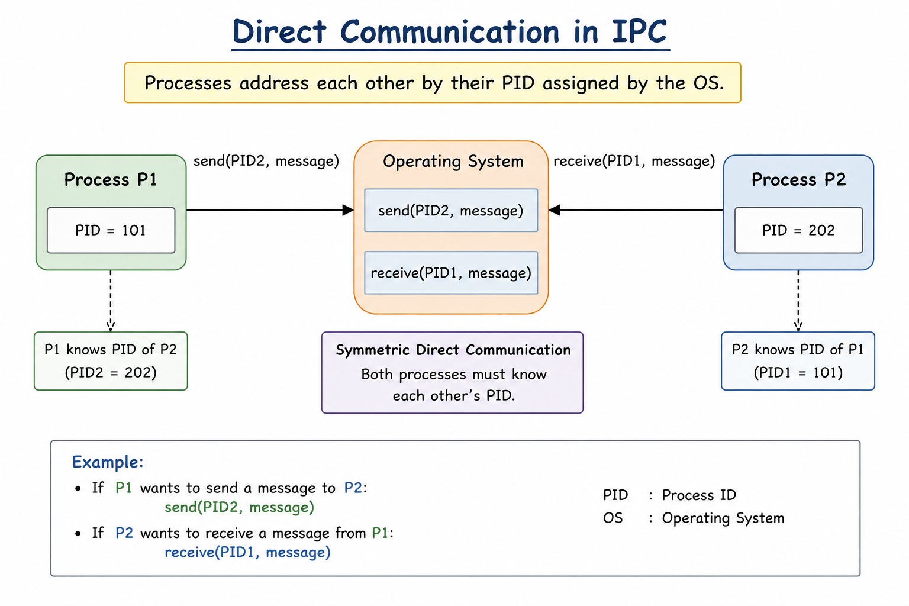

Slide 16
Direct Communication: Asymmetric
Asymmetry in addressing between sender and receiver
Sender addresses receiver explicitly: send(PID2, message)
Receiver does not need to know sender's PID: receive(id, message)
Kernel replaces 'id' parameter with sender's actual PID
Receiver discovers sender identity at message arrival
More flexible than symmetric addressing
Useful for server processes accepting from multiple clients
One-way knowledge requirement

Slide 17
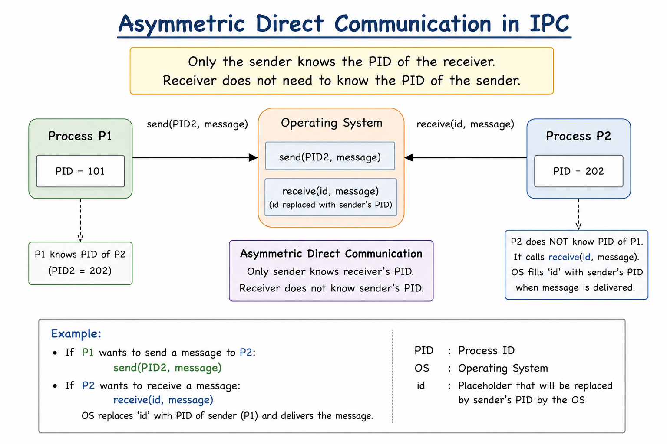

Slide 18
Synchronization: Blocking vs Non-blocking
Blocking
(Synchronous)
Non-blocking
(Asynchronous)
Blocking Send:
• Sender blocked until received
Blocking Receive:
• Receiver blocked until available
Advantage: Guaranteed sync
Non-blocking Send:
• Sender continues after send
Non-blocking Receive:
• Returns message or NULL
Advantage: Uninterrupted
Notes:
Blocking send: If a process (say, P₁) invokes send() call to send a message to another process (say, P₂) or to a mailbox, the operating system blocks P₁ until the message is received by P₂ or by the mailbox.
Blocking receive: If there is no message available for P₂ when it invokes the receive() system call, the operating system blocks it until some message arrives for it.
Non-blocking send: P₁ sends the message and continues to perform its operation without waiting for the message delivery by P₂ or by mailbox.
Non-blocking receive: When P₂ invokes a receive() call, it either gets a valid message if some message is available for it or NULL if there is no message available for it.

Slide 19
Indirect Communication via Mailbox
Messages sent and received through mailbox (port)
Mailbox: Repository acting like a postbox for messages
Decouples sender and receiver - don't need to know each other
Multiple senders can write to one mailbox
Only owner (creator) can receive from mailbox
Other processes send by knowing mailbox ID
System calls: send(X, message) and receive(X, message)

Slide 20
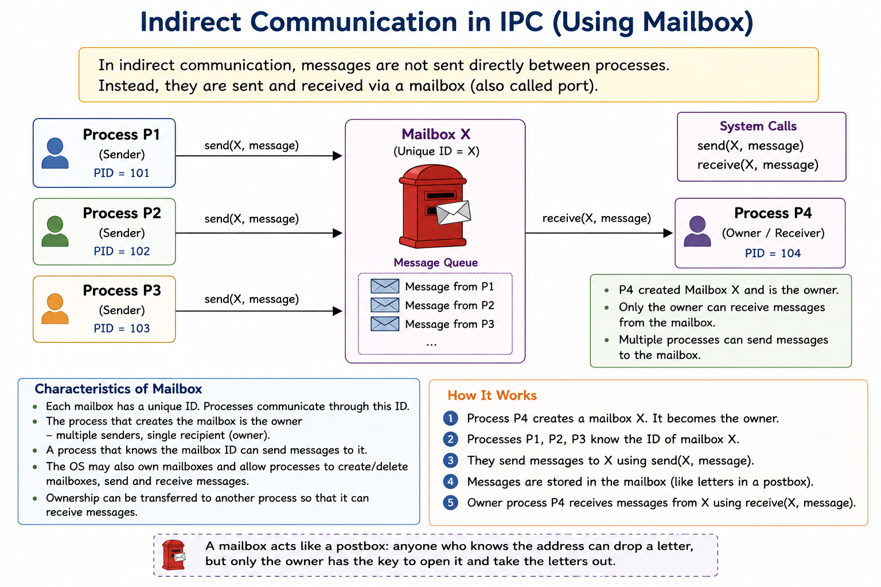

Slide 21
Mailbox Characteristics
Unique Identification
Each mailbox has unique ID for process communication
Ownership
Creator is owner and only receiver; others are senders only
Multiple Senders
Multiple processes can send to same mailbox simultaneously
Single Receiver
Only one process (owner) can receive from a mailbox
OS Management
Operating system can also own and manage mailboxes
Ownership Transfer
OS may transfer mailbox ownership to other processes

Slide 22
Direct vs Indirect Communication
Links
One per process pair
Multiple possible
Association
Two processes
Mailbox
Establishment
If PID known
Shared mailbox ID
Scope
Point-to-point
Multiple processes
Flexibility
Limited options
Flexible

Slide 23
Message Buffering Strategies
No Buffering
Zero capacity - sender waits until message received
Bounded Buffer
Fixed capacity - sender blocked if queue full
Unbounded Buffer
Unlimited capacity - sender never blocked
Double Buffering
Two buffers alternate - improves efficiency
Notes:
The messages sent by a process are temporarily stored in a temporary queue (also called buffer) by the operating system before delivering them to the recipient. This buffer can be implemented in a variety of ways, which are as follows:
No buffering: The capacity of buffer is zero, that is, no messages may wait in the queue. This implies that sender process has to wait until the message is received by the receiver process.
Bounded buffer: The capacity of the buffer is fixed, say m, that is, at most m processes may wait in the queue at a time. When there are less than m messages waiting in the queue and a new message arrives, it is added in the queue. The sender process need not wait and it can resume its operation. However, if the queue is full, the sender process is blocked until some space becomes available in the queue.
Unbounded buffer: The buffer has an unlimited capacity, that is, an infinite number of messages can be stored in the queue. In this case, the sender process never gets blocked.
Double buffering: Two buffers are shared between the sender and receiver process. In case one buffer fills up, the second one is used. When the second buffer fills up, the first might have been emptied. This way the buffers are used turn by turn, thus avoiding the blocking of one process because of another.

Slide 24
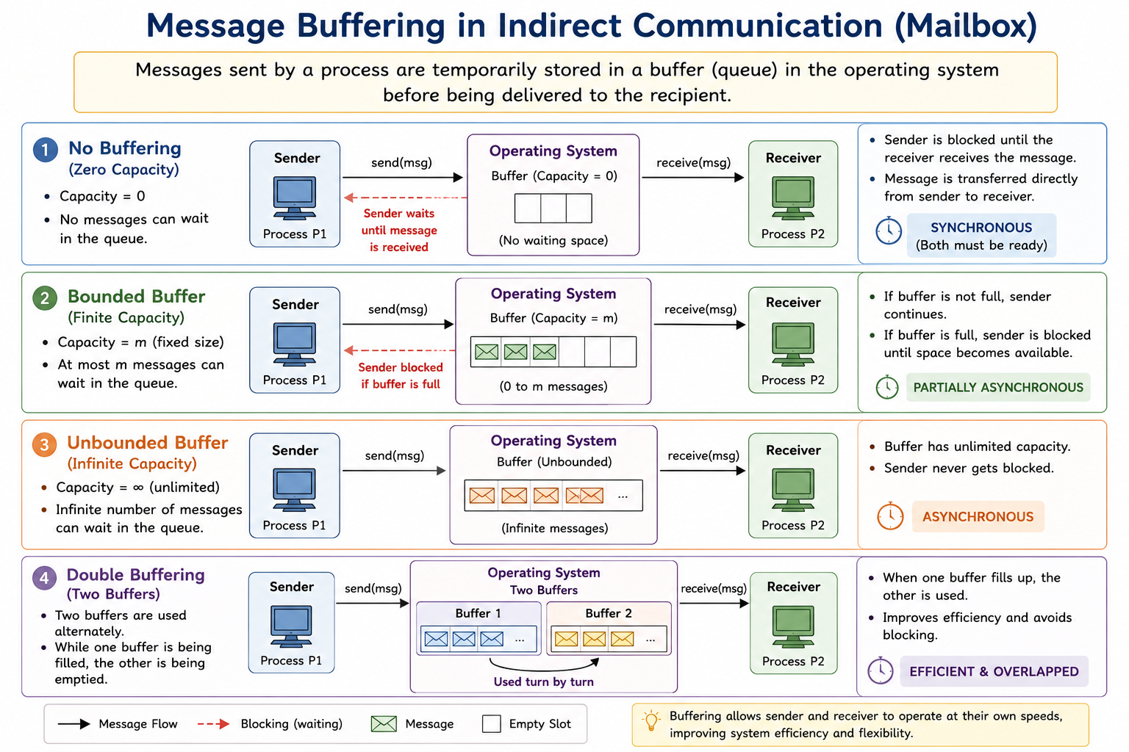

Slide 25
Pipes: IPC Mechanism
Standard communication mechanism for data transfer between processes
Definition: It provides a means of one-way communication between related processes.
Structure: Each pipe has read end and write end
Data Flow: Bytes written at write end appear at read end
Management: Operates as FIFO queue with shared buffer
Related Processes: Works with processes related through fork
Synchronization: UNIX uses locks and wait queues
Implementation: Managed at kernel level for coordination

Slide 26
Pipe Synchronization and Operation
UNIX ensures single process accesses pipe at a time
Locks: Pipe locked when process accesses it
Wait Queues: Each pipe end has associated wait queue
Writer Process: Locks pipe if space available, waits if full
Reader Process: Sleeps if no data, awakened when data written
Data Transfer: Bytes copied to/from shared buffer
Coordination: Reader awakened when data arrives, writer after read
FIFO Ordering: Data processed in order written

Slide 27
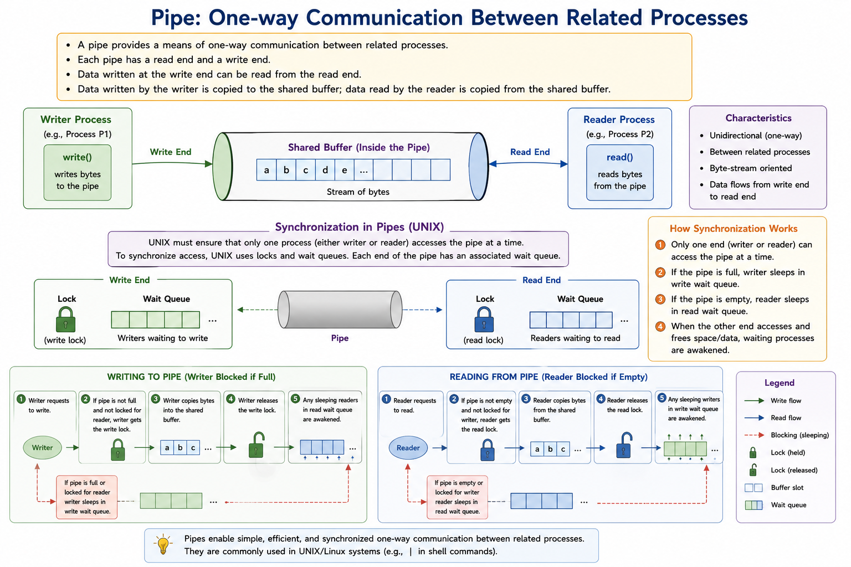

Slide 28
Pipes: Advantages and Disadvantages
Advantages
Disadvantages
Simple and straightforward
Efficient data transfer
Reliable communication
Error detection capability
Fast within same system
Flexible protocols
Limited capacity
Unidirectional only
Requires synchronization
Limited scalability
Related processes only
Fixed size buffer

Slide 29
Message Queues: Advanced IPC
Linked list of messages stored in kernel, identified by unique ID
FIFO Organization: Messages stored and retrieved in FIFO order
Message Type: Each message has positive long integer type field
System Calls: msgget(), msgsnd(), msgrcv(), msgctl()
Flexible Retrieval: Can fetch messages by type, not just FIFO order
Asynchronous Communication: Messages queue, retrieve when ready
Kernel Managed: OS maintains message queue structure and state
Robust Method: Most common IPC mechanism for queued communication

Slide 30
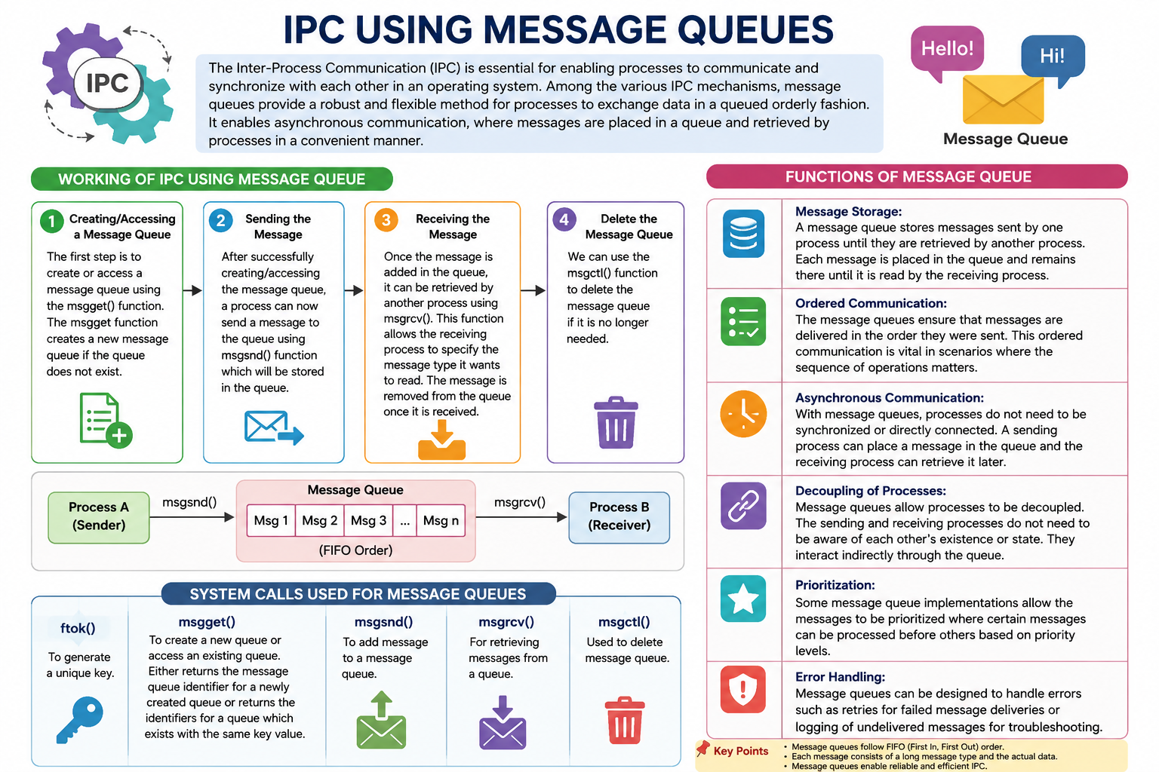

Slide 31
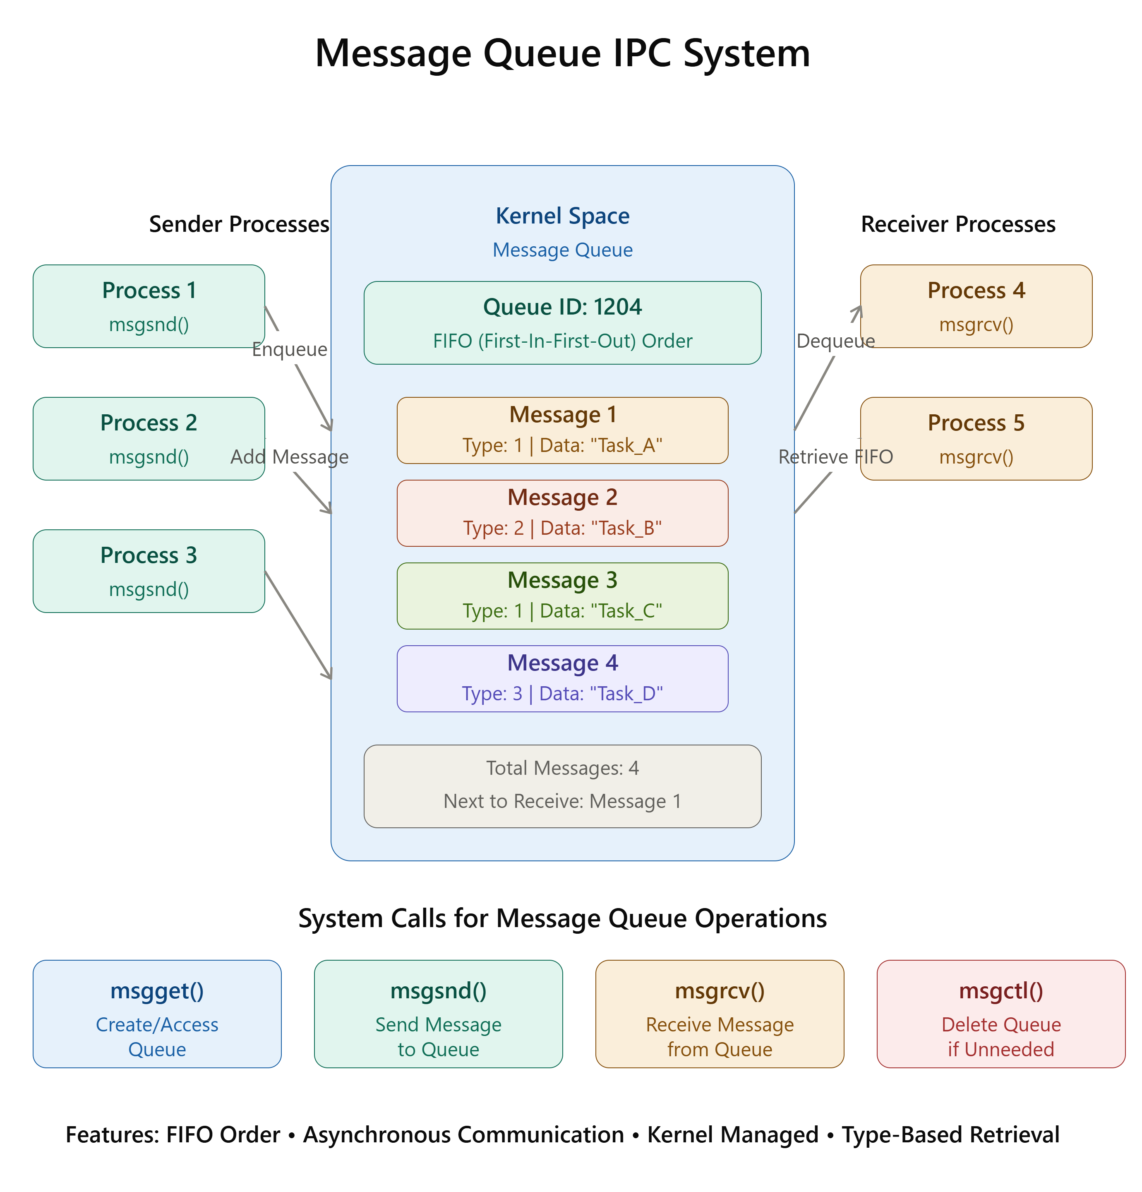

Slide 32
Message Queue System Calls
ftok()
Generates unique key for message queue identification
msgget()
Creates new queue or accesses existing queue, returns ID
msgsnd()
Adds message to queue with type and content
msgrcv()
Retrieves message from queue, can specify message type
msgctl()
Deletes message queue when no longer needed

Slide 33
Functions of Message Queue
Message queues are powerful IPC tools that enable robust process communication with key capabilities:
1. Message Storage
2. Ordered Communication
3. Asynchronous Communication
Stores messages from one process until retrieved by another. Messages remain queued until read by receiving process.
Ensures messages are delivered in the exact order they were sent. Critical for scenarios where sequence matters.
Processes don't need to be synchronized. Sender places message and receiver retrieves it later at their convenience.
4. Decoupling of Processes
5. Prioritization
6. Error Handling
Sender and receiver processes are independent and don't need to know about each other. Improves modularity and scalability.
Some implementations allow messages to be prioritized. Certain messages can be processed before others based on priority levels.
Handles errors with retry mechanisms for failed deliveries and logging of undelivered messages for troubleshooting.
Key Insight: Message queues enable robust, decoupled, and fault-tolerant inter-process communication

